Slide 1


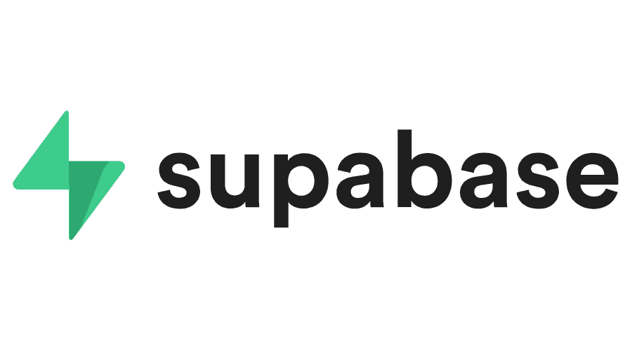

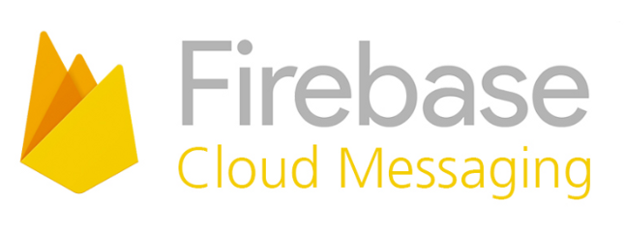
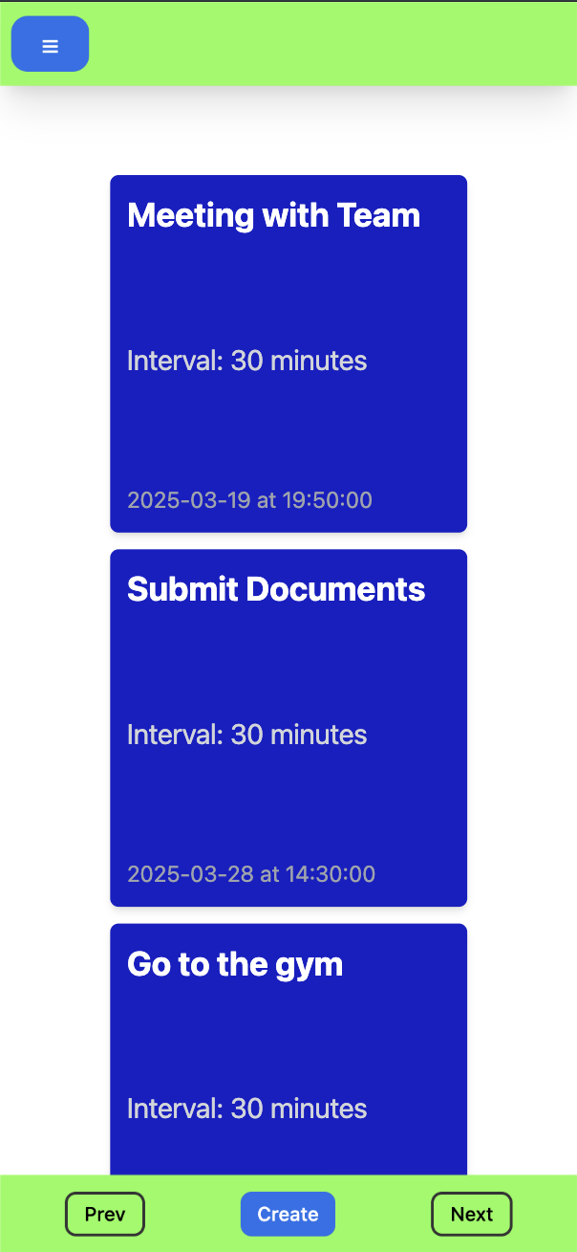
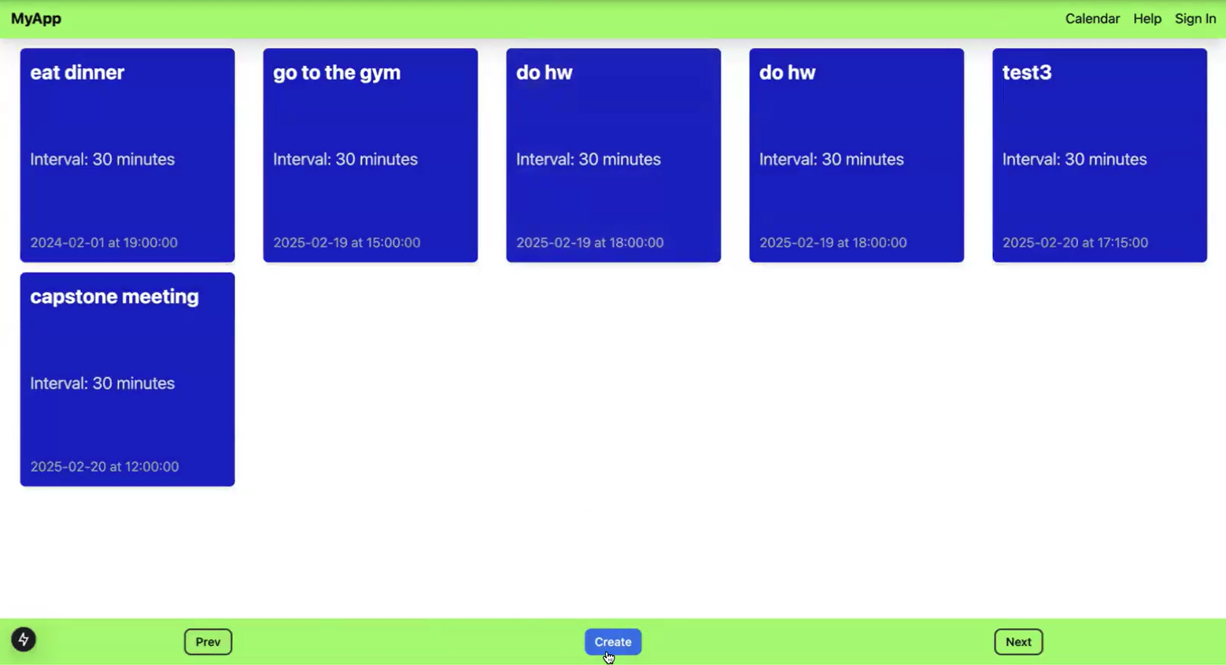
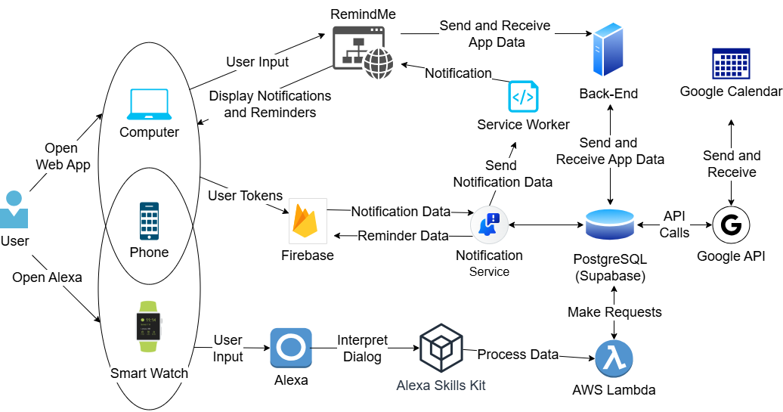
25-317
Web Notification System with Alexa Integration
Team members: Lavale Butterfield, Rebecca Browder, Parker Dizon, Aryan Garg | Faculty adviser: Tamer Nadeem, Ph.D. | Sponsor: QL Plus | Mentor: Kristie Yelinek
Design
We’re creating a web notification system for our client, Karina, who was diagnosed with Post-Traumatic Stress Disorder (PTSD). Our goal is to develop a product that will allow her to become more self-reliant throughout her daily routine.
This application has the following features:
Alexa integration to accommodate voice control
Create and host calendar events from Google calendar
Personalized reminders that will occur in constant intervals leading up to the event
Web notifications to the phone and calendar
Detailed instructions and tutorials for users who are not familiar with technology
Impact
Our sponsor, QL Plus, collaborates with
universities to create solutions for veterans
and first responders. We hope that the
development of this application will extend
beyond our client, benefiting many others who
need assistance with daily tasks.
We focused on accessibility to accommodate a large range of users. Many designs that are on the market, are often too complex and distracting. Our goal is to make digital task management more approachable and beneficial for users with PTSD and similar challenges.
This platform allows users to access their calendar information and personalized reminders all in one place. The addition of voice control helps reduce time and minimize confusion when navigating the site. Our client has emphasized that regaining independence can have a profound impact on the lives of individuals in similar situations.
Framework
Phone and Computer are used to add, edit, and view calendar events and reminders
Watch and Phone have Alexa capabilities to create reminders
Phone and computer display web notifications
Alexa Skills Kit creates a custom command for Alexa to use with our application
ASK connects to AWS Lambda to send information to the database
Back-end processes requests for AWS Lambda and the website as well as making the API calls to Google calendar
Supabase Cloud Server / PostgreSQL Database is used to store reminders and easily handle notifications with real-time communication to update the website
Firebase Cloud Messaging facilitates communication between Supabase server and user’s devices by handling notification data and sending it to multiple devices
User Interface: Mobile
User Interface: Desktop
Framework Architecture

